Slide 1
INFO215: Week 3a
Tracking + Facial Recognition

Slide 2
Review: What have we learned in the past two weeks? What has been the most interesting aspect for you?

Slide 3

https://www.youtube.com/watch?time_continue=1&v=WOo6HK48Kjo&feature=emb_logo

Slide 4

Ghostery Exercise: The next slides contain some screenshots of sites I just visited (Oct 4, 2022) using Ghostery to identify trackers those sites employ. As a group, please search for information about the trackers each site uses. (Trackers are shown in the purple box on each screen.)

Slide 5
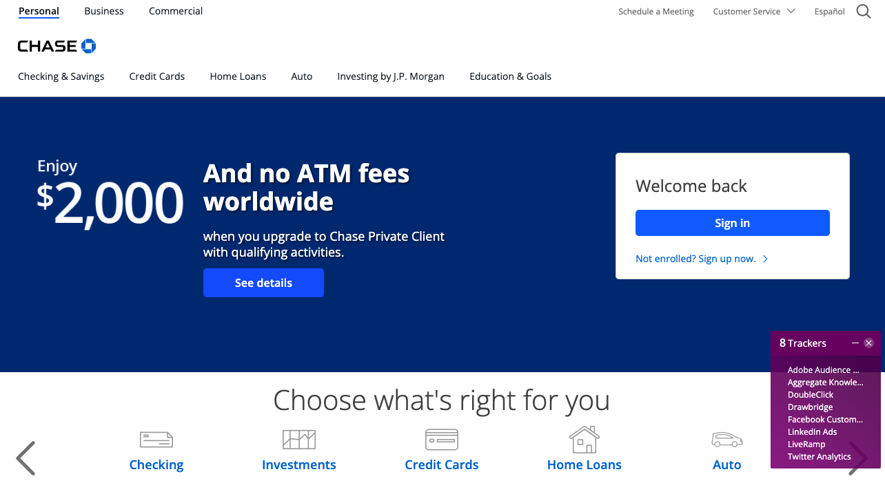

Slide 6


Slide 7
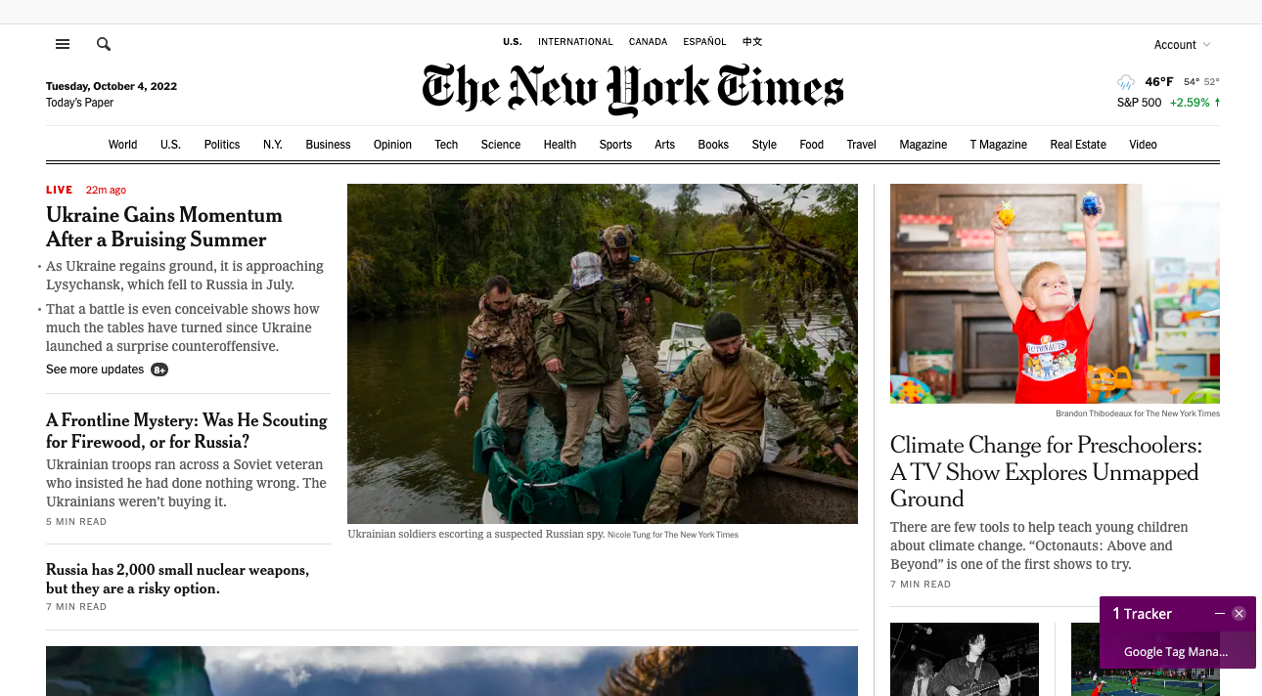

Slide 8
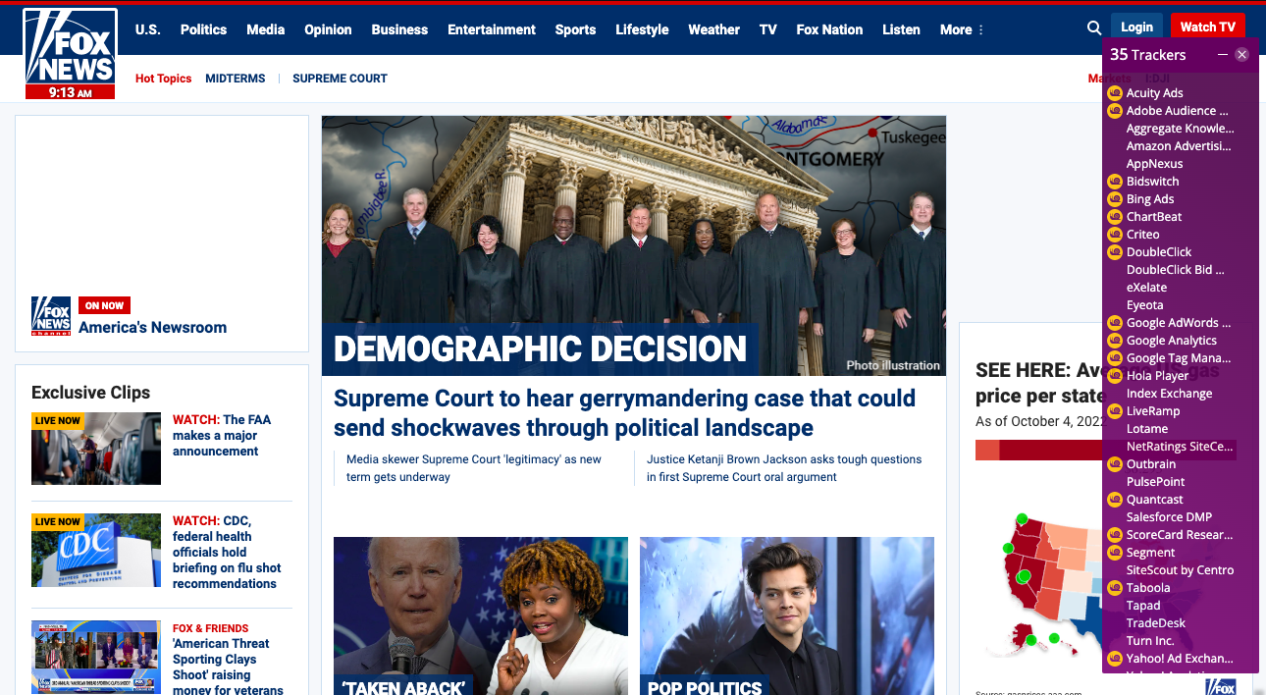

Slide 9
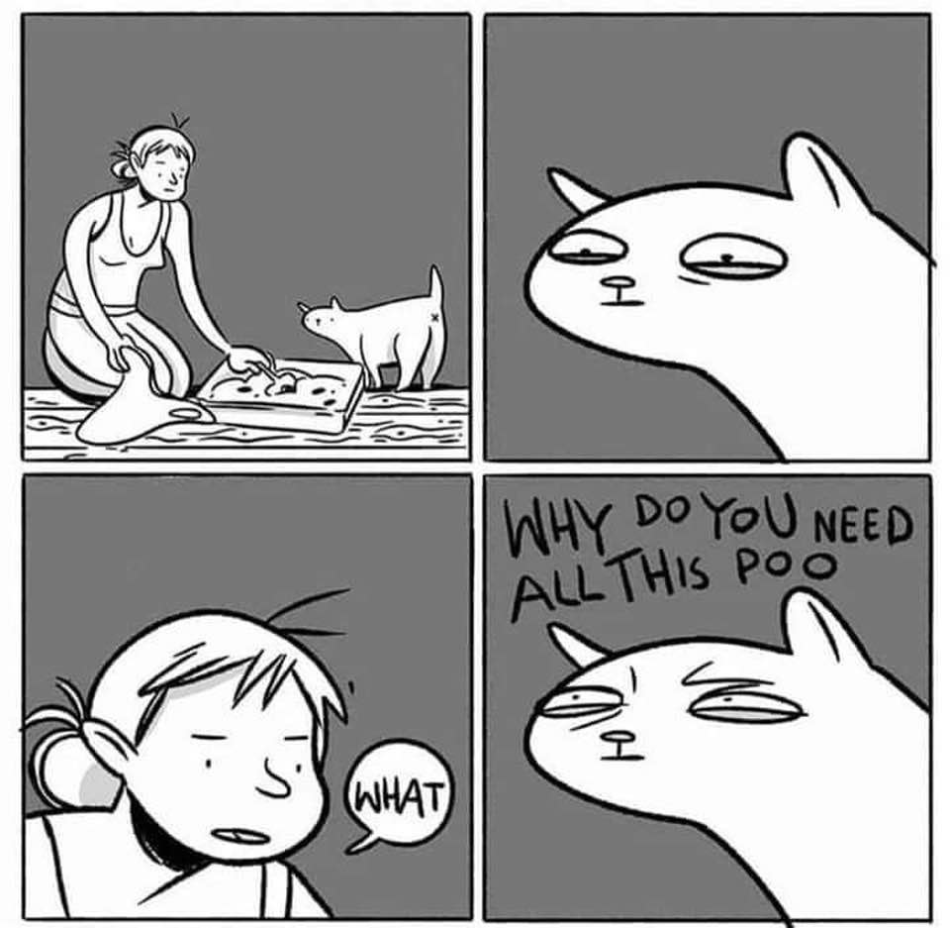
Reflections on Ghostery + Tracking

Slide 10

ALGORITHMIC BIAS AND DIGITAL EQUITY
https://www.youtube.com/watch?time_continue=1&v=tia5OHE98F4&feature=emb_logo
What’s the connection between algorithmic bias and our discussion on technology for a good society?

Slide 11
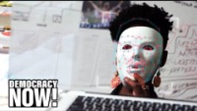
https://www.youtube.com/watch?v=gkbNH39QE0Q&feature=emb_logo

Slide 12
A Civil Debate
Divide up into pro- con- groups ☺ (Some may have to play devil’s advocate)
Consider Facial Recognition in Different Circumstances:
Has it been positive? Negative? In what ways?
Where is it helpful/harmful?
In what ways has the social context in which the technology is used changed as a product of the tech?
For future technologies: How can we ensure that they support the values of a good society?

Slide 13
Reminder:
Assignment #1 Due on October 13
Notes:
Who is ‘us’ who is ‘we’?

